Slide 1
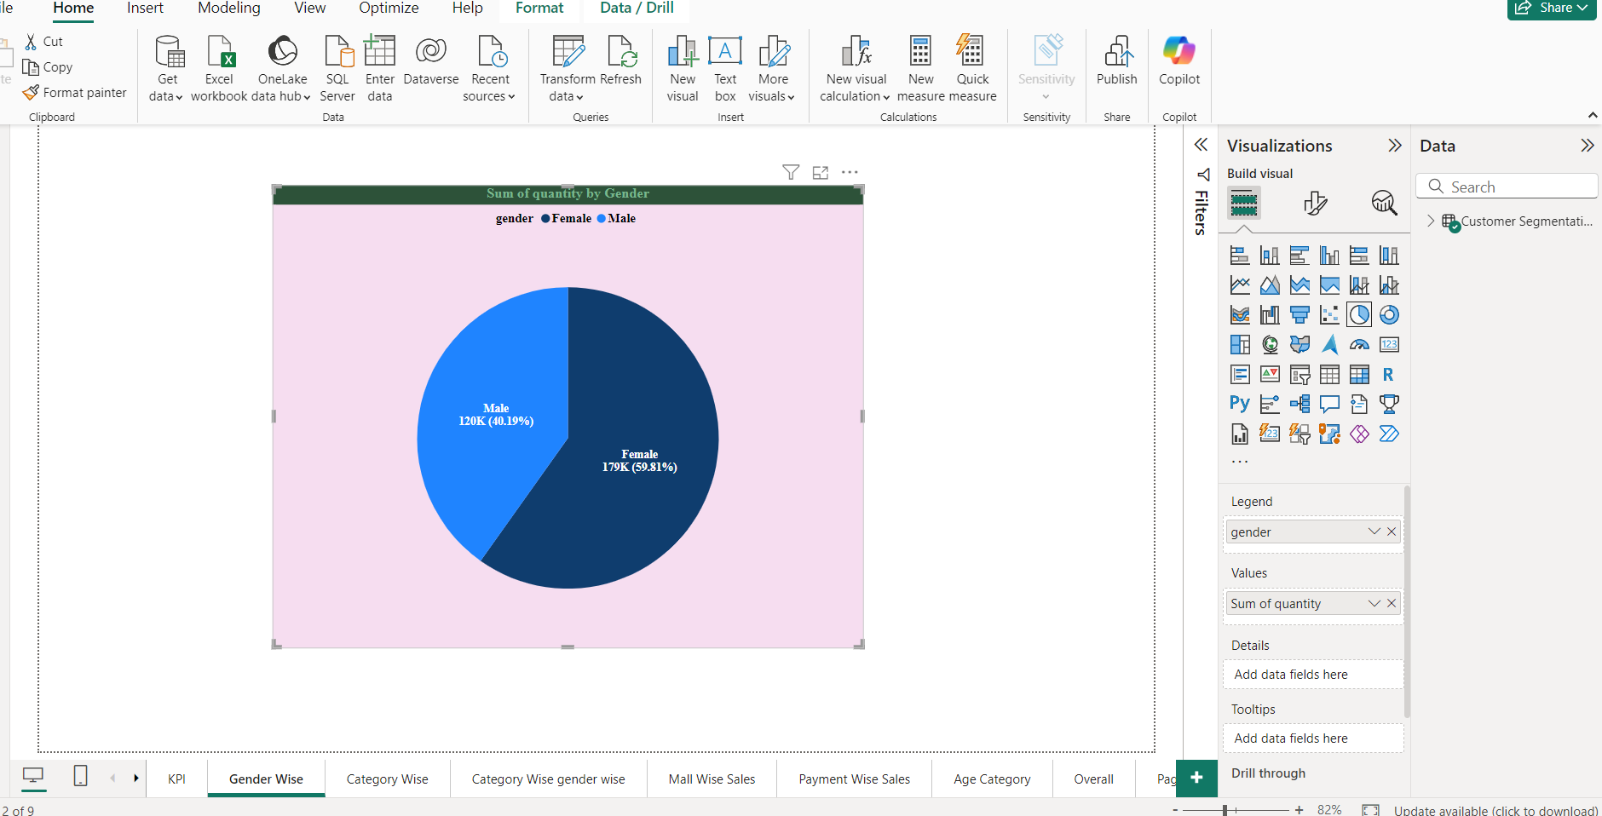
Customer Segmentation Analysis
Quantity by Gender (Pie Chart)
The Pie Chart shows the sum of quantities purchased by gender. It clearly indicates that female customers purchased more items (179K, or 59.81%) than Male customers (120K, or 40.19%). This highlights the importance of the female segment in driving sales volume.

Slide 2
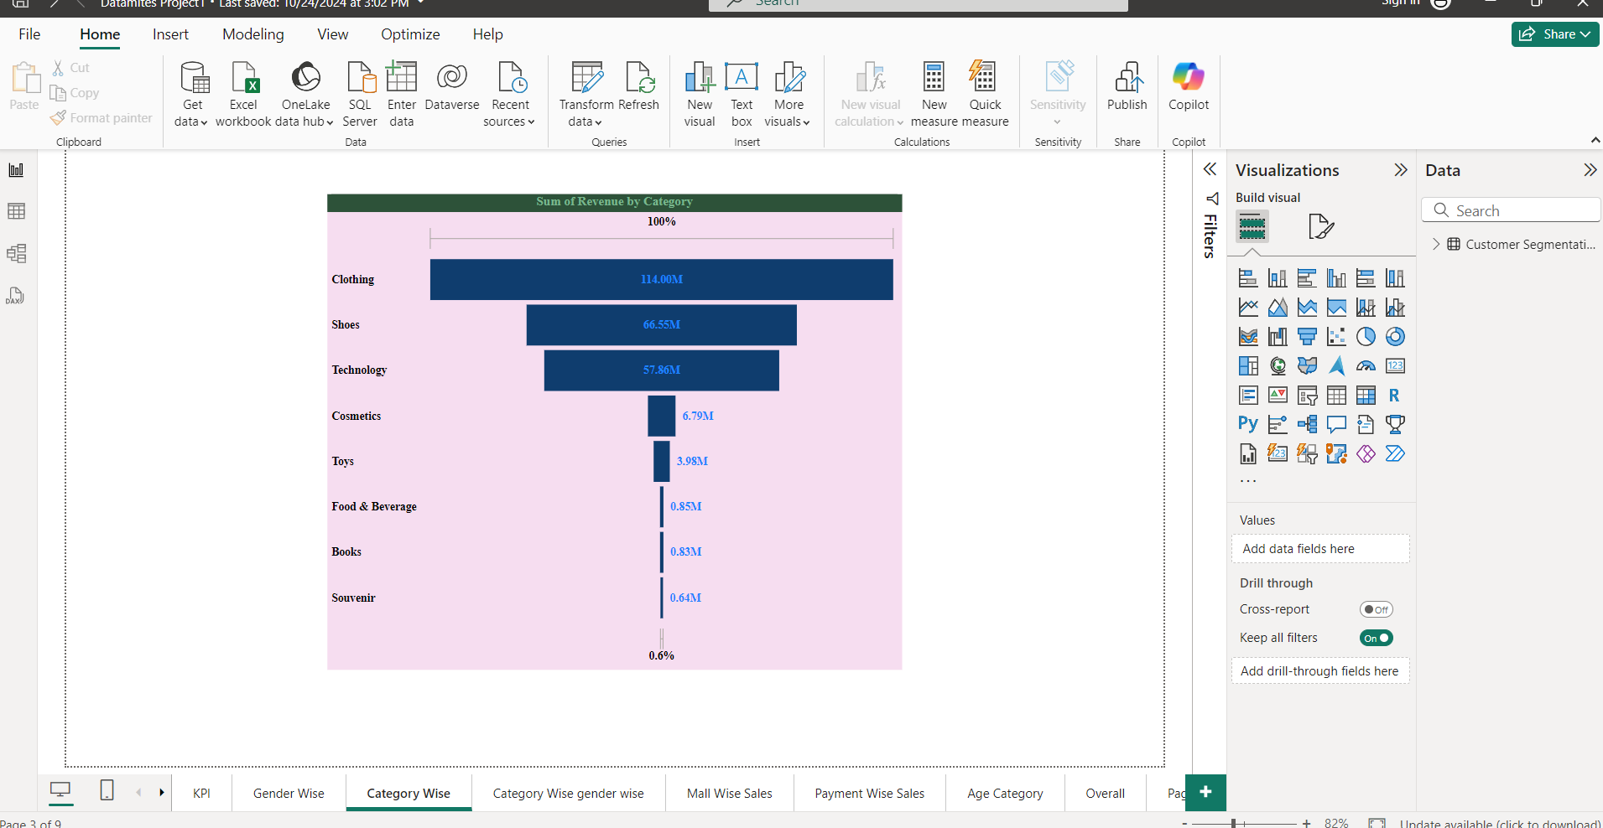
Revenue by Category (Funnel Chart)
The Funnel Chart illustrates the sum of Revenue by category. It establishes that clothing is the dominant revenue generator with $114.00, followed by Shoes ($66.55M) and Technology ($57.60). The remaining categories contribute significantly less revenue, underscoring the report's focus on the top three segments

Slide 3
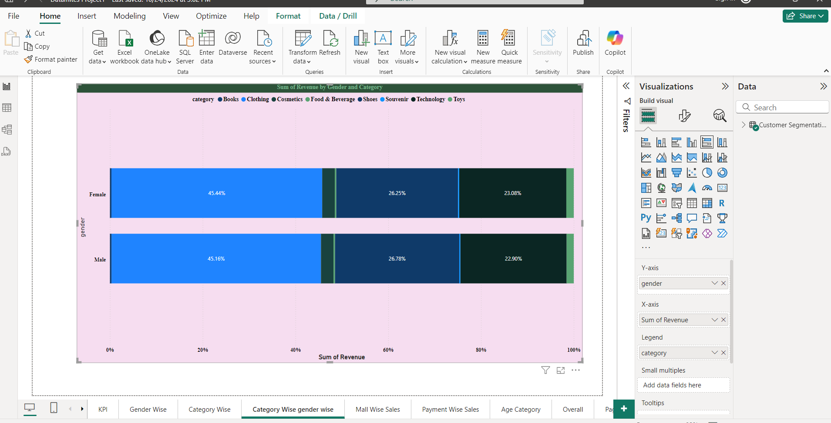
Revenue by Gender and Category (Stacked Bar Chart)
This Stacked Bar Chart breaks down the sum of Revenue by both gender and category. It reveals that spending patterns are very similar, with both Female (45.44%) and Male (45.16%) customers spending the highest proportion of their money on Clothing. This similarity in category preference suggests that targeted category-based campaigns may appeal to both genders equally.

Slide 4
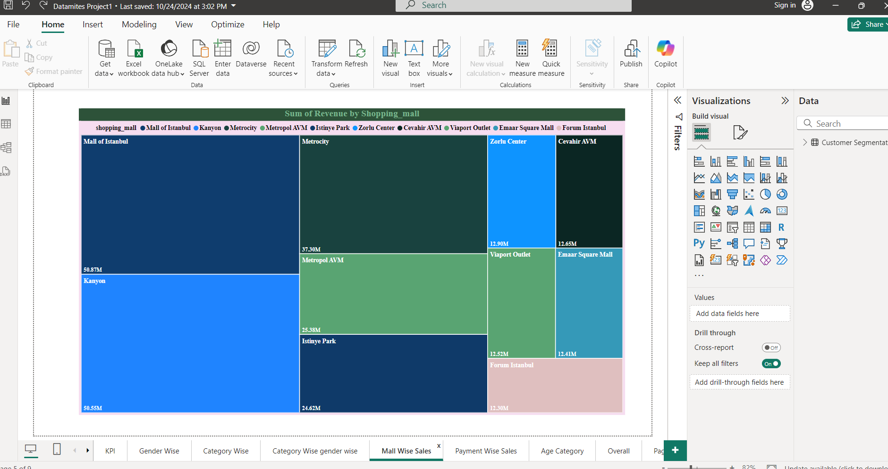
Revenue by Shopping Mall (Tree Map Chart)
The Tree Map Chart displays the sum of Revenue by shopping mall.
It pinpoints Mall of Istanbul ($59.87) and Kanyon ($56.55) as the top two highest revenue-generating locations. This visualization helps identify key geographic areas for investment or resource allocation.

Slide 5
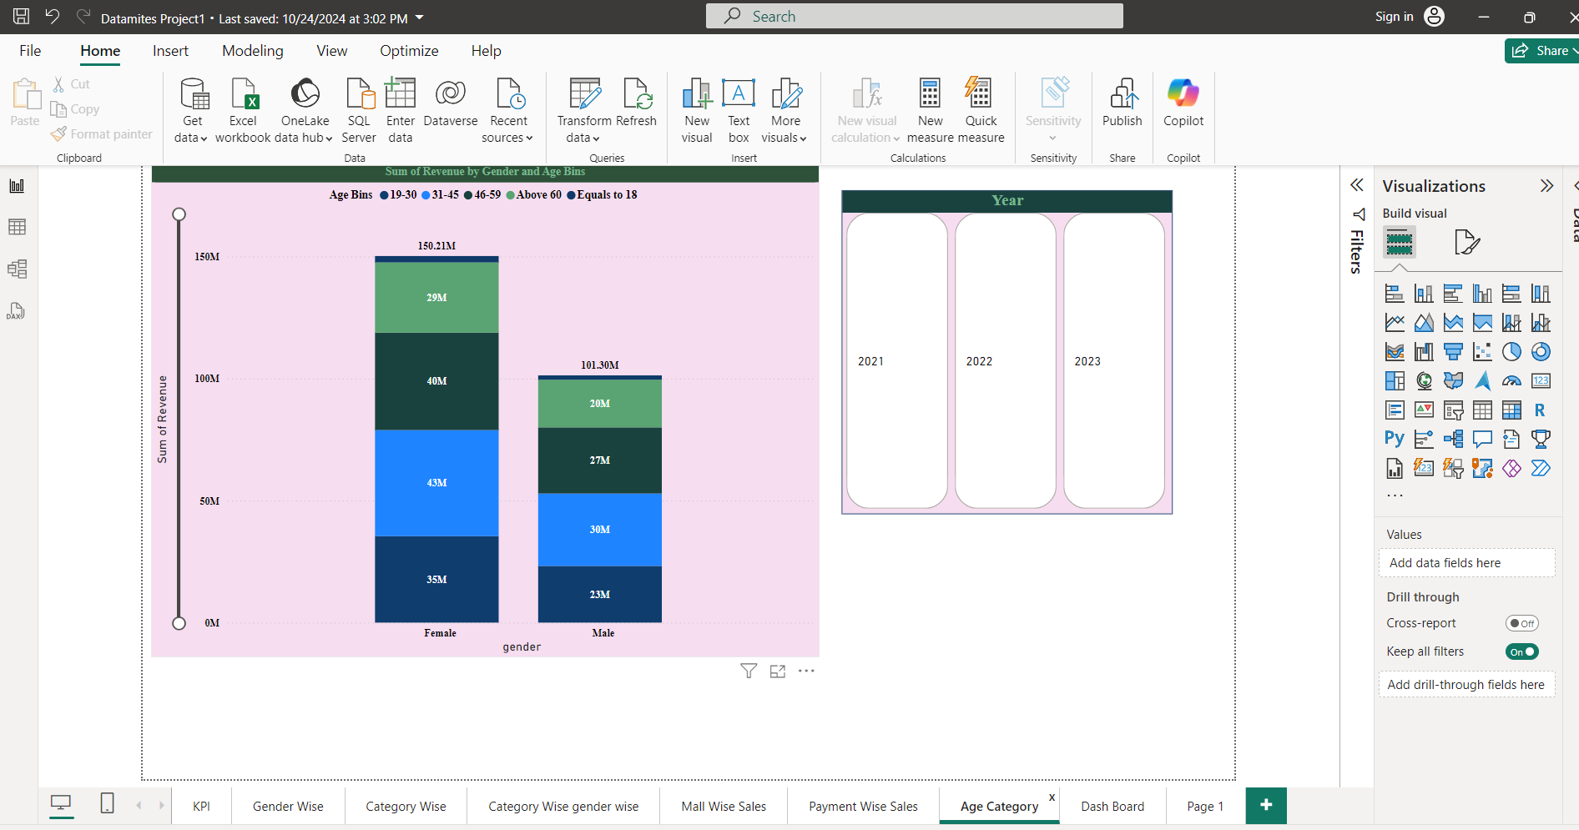
Revenue by Gender and Age Bins (Stacked Column Chart)
This Stacked Column Chart analyzes the sum of Revenue by gender and specific age bins. It shows that the female segment generates a higher total revenue ($159.12) than the male segment ($101.59). For both genders, the 31-45 age bin is the highest-spending group (Female: $59M, Male: $38M)

Slide 6
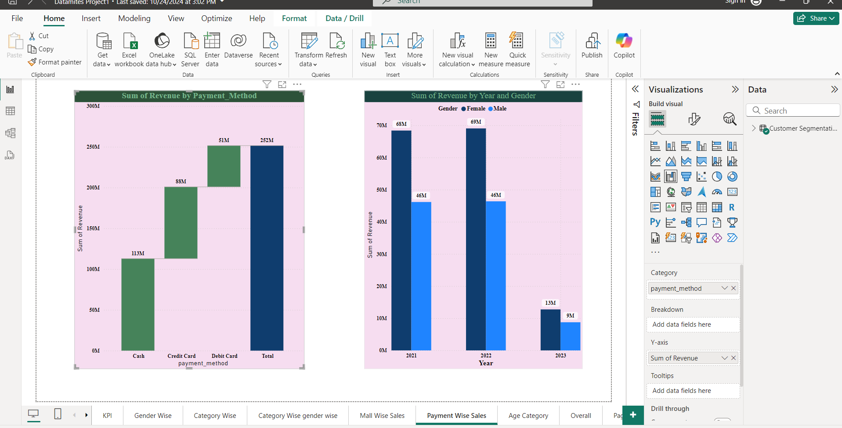
Revenue by Payment Method & Revenue by Year and Gender (Two Charts)
The Payment Wise Sales page contains two visuals.
The Waterfall Chart on the left shows that the Debit Card is the most preferred payment method, contributing to the highest final revenue total.
The Clustered Column Chart on the right highlights a major temporal trend: total revenue was highest in 2022 and experienced a sharp drop in 2023.

Slide 7
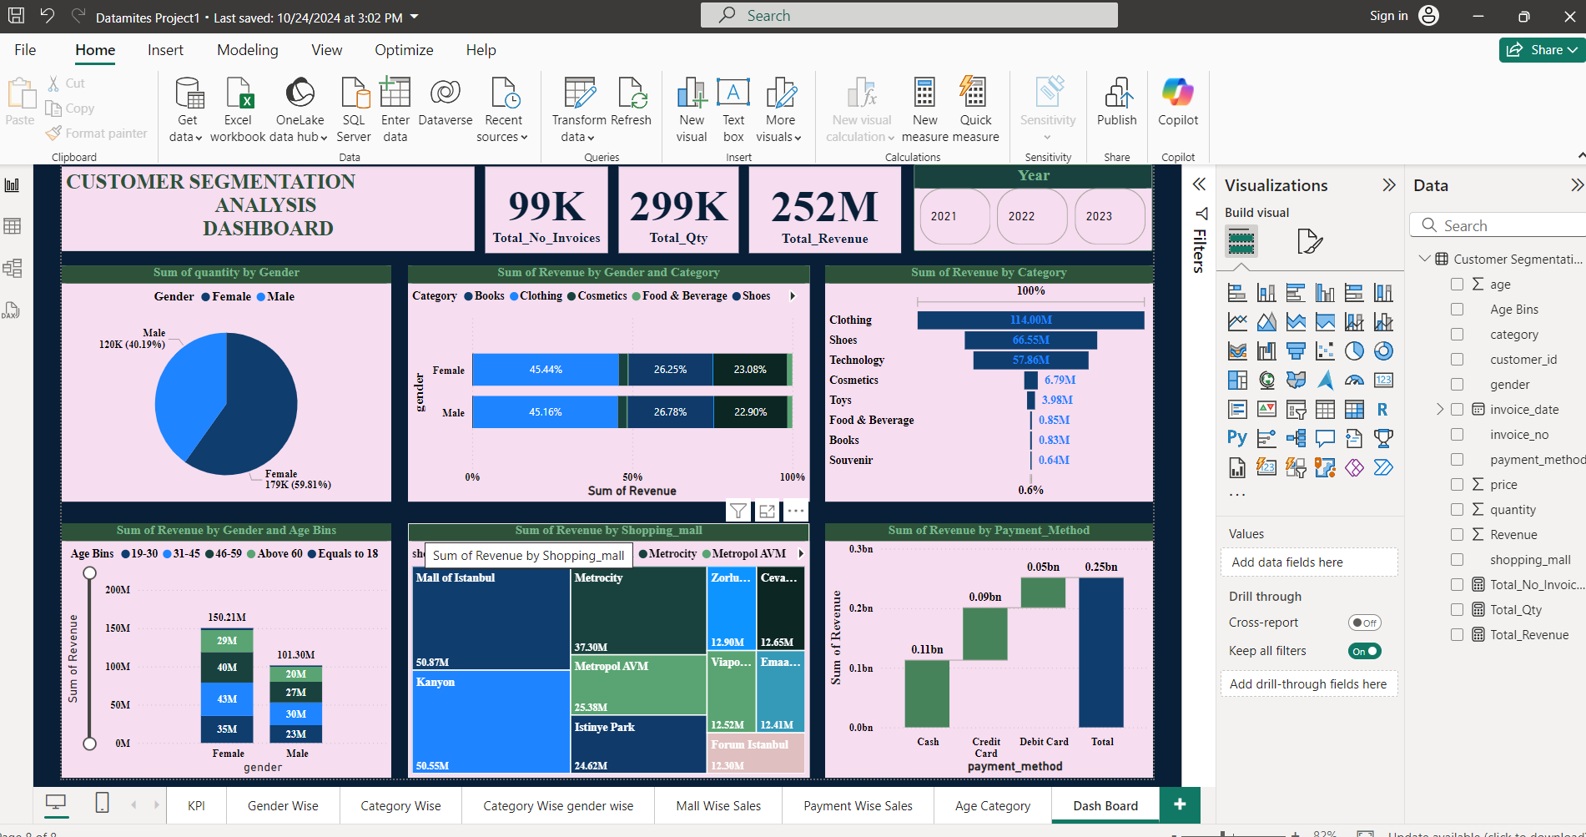
Dashboard

Slide 8
Summary Of Dashboard
The Customer Segmentation Analysis Dashboard provides a comprehensive overview of sales performance, showing a total of 99K invoices, 299K total quantity sold, and $252M in total revenue.
The analysis reveals that the female segment is the most dominant customer group, accounting for the higher quantity of sales (120K vs 179K) and generating the majority of the revenue ($159.22M) compared to the male segment ($101.30M). This revenue is heavily concentrated in the 31-45 age bin for both genders. In terms of product preference, both males and females spend the most on Clothing, followed by Shoes and Technology.
Geographically, sales are led by malls like the Mall of Istanbul and Kanyon.
The most common payment method is the debit Card. A critical trend evident in the data is a sharp decline in revenue in the 2023 year compared to 2021 and 2022.
The core business insight from the customer segmentation analysis is
Critical importance of the Female segment, particularly those aged 31-45, as the primary revenue driver. This group generates the highest overall revenue and sales volume, dictating that marketing and loyalty programs should be heavily optimized toward their preferences. Product focus must remain on the Clothing, Shoes, and Technology categories, as they dominate sales and show similar spending patterns across both genders.
Geographically, the strong performance of Mall of Istanbul and Kanyon suggests these locations should be prioritized for inventory, promotions, and store experience.
Strategically, the Debit Card is the most successful payment channel. Most urgently, the business must investigate the sharp, critical decline in revenue observed in
2023 compared to the prior two years to identify and mitigate the underlying market or operational issues immediately.

